Slide 1
Convolutional Neural Networks (CNNs)

Slide 2
Definition of CNN
Convolutional Neural Networks (CNN) are a specialized type of Neural Networks that are capable of processing grid like data topology
Typical data types
Time series data that can be considered to have 1D grid topology containing discrete samples at regular intervals
Image data that can be considered as 2D and 3D grid of pixels
CNN use the convolution mathematical operation
Uses convolution mathematical operations instead of the general matrix multiplication in at least one of its layers

Slide 3

What is Convolution?
Convolution is a mathematical operation involving two functions
Consider a sensor system which outputs 𝑥(𝑡), at time 𝑡
Since both $x and t$ are real valued, different sensor outputs can be obtained at any instant of time
Sensor outputs are typically noisy, and therefore an average of sensor outputs are computed to reduce the noise level
Averaging can be done by considering more recent sensor outputs or weighted averaging

Slide 4

What is Convolution?
Let $w\left(a\right)$ be the weighting function with $a$ be the age of the sensor output
Applying a weighted average operation at every instant of time on the sensor output $x\left(t\right)$, a new smoothed estimate of $x\left(t\right)$ known as $S\left(t\right)$ is generated as:
$S\left(t\right)=\int{x\left(a\right)w\left(t−a\right)da},$ known as the convolution
$S\left(t\right)=\left(x∗w\right)\left(t\right),$ where $∗$ is the convolution operator
In general,
$x$ is termed as the input of the convolution operation
$w$ is termed as the kernel of the convolution operation
$S$ is termed as the feature map (output) of the convolution operation

Slide 5

What is Convolution?
The outputs of a realistic sensor is not continuous and discretized.
Assuming $x$ and $w$ are discretized only on integer values of $t$, the discrete convolution is
$S\left(t\right)=\left(x∗w\right)\left(t\right)=\sum_{a=−∞}^{∞}{x\left(a\right)w\left(t−a\right)} (1)$
In AI/ML, the input $x$ is typically multi-dimensional array of data, and $w$ the kernel is a multi-dimensional array of parameters (weights) that are determined by the training algorithm
In practice, the eqn.(1) is implemented as a summation over a finite number of array elements of $x$ and $w$
Convolutions in the CNN are implemented over more than one dimension or axis

Slide 6
Convolution: 2D
An image with respect to Neural Networks, is a discrete two-dimensional entity
The two-dimensional entity is a 2D array of pixel values describing a scene at a fixed time (frame)
Image analysis is one of the important applications of convolution
Convolution techniques are used to extract local patterns in an image
The simplest and naïve approach is to rasterize (rearrange) the image into a 1D array and apply 1D convolution.

Slide 7

2D Convolution Architecture
Input: A two dimensional array, represented as a matrix [H;W]
H is the height and W is the width of the array respectively to represent input array size in 2D convolution.
Output: A two dimensional array, represented as a matrix $o=\left[o_{H},o_{W}\right]$ of the output 2D array in 2D convolution
Kernel: A kernel is a small two dimensional array of weights whose size is a parameter of the convolution
Stride: The number of input elements over which the kernel slides in both x and y directions upon completing a single step
Padding: As the kernel slides towards the extremity of the input array, parts of it may fall outside the input array, thus zeros are added to ensure this doesn’t happen

Slide 8
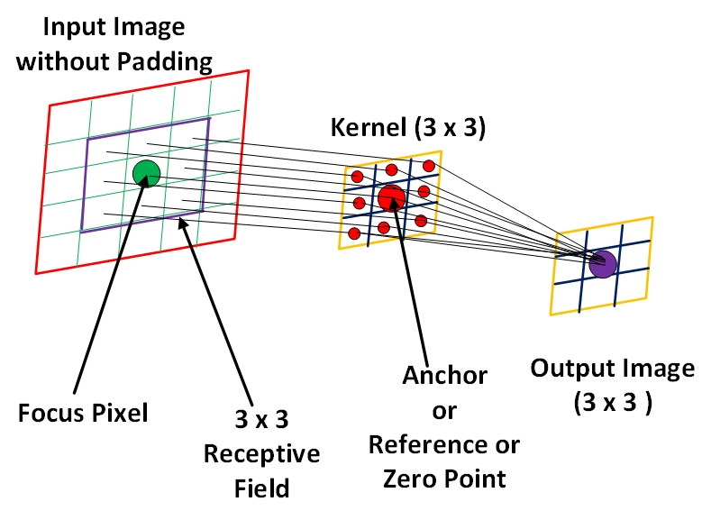
Convolution- Pictorially

Slide 9
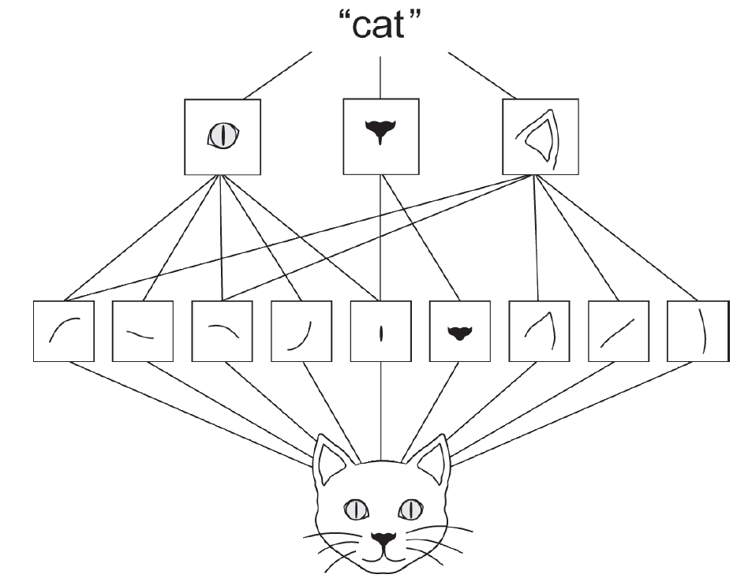
Application- Identifying Images of Dogs and Cats
Dataset contains labeled pictures of cats and dogs
CNN will be used to identify (within a probability) if the image is a cat or dog
CNN will pick out key features to determine the classification
Black box approach- features that are selected are not deterministic
Visual word forming a spatial hierarchy of visual modules
(Ref: Deep Learning with Python, 2nd Edition, Francois Chollet)

Slide 10
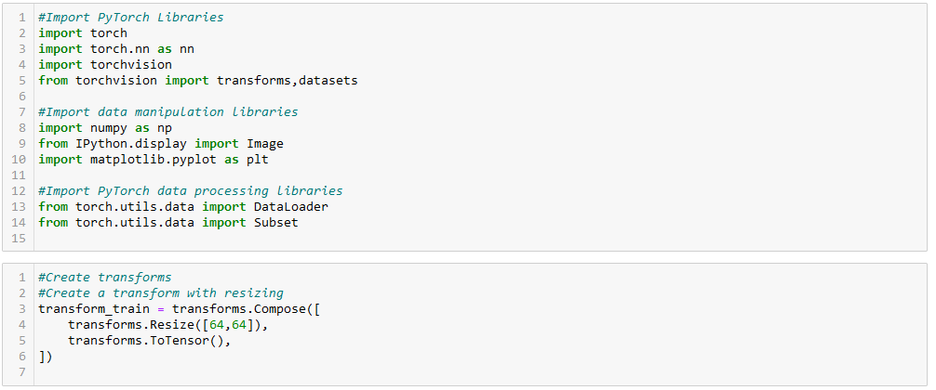
Code- Classifier_CatsDogs_Template.py

Slide 11
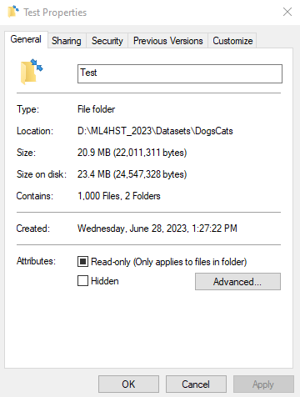
Code- Determine Dataset Path
Navigate to where your “DogsCats” folder is in the File Explorer
Click into this folder to where you can see the three subfolders: Test, Train, and Val
Right click on any of these folders and select properties
Path is listed under Location, select and copy (ctrl+c)

Slide 12
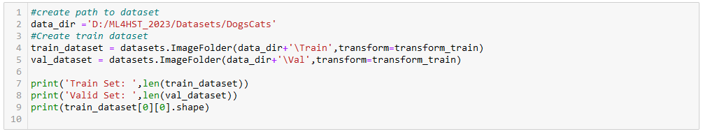
Code- Classifier_CatsDogs_Template.py
Replace the path within the quotes on line 2 with the path that you just copied
Change all backslashes (\) to forward slashes (/)

Slide 13
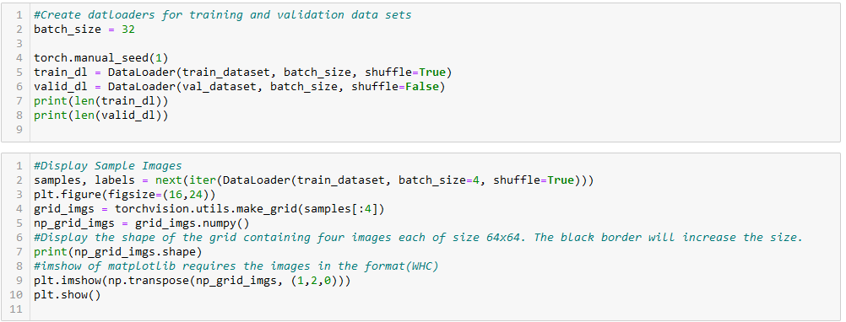
Code- Classifier_CatsDogs_Template.py

Slide 14
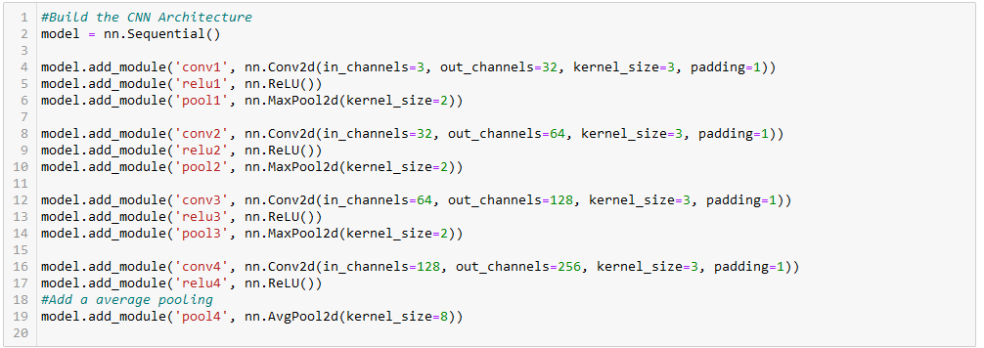
Code- Classifier_CatsDogs_Template.py

Slide 15
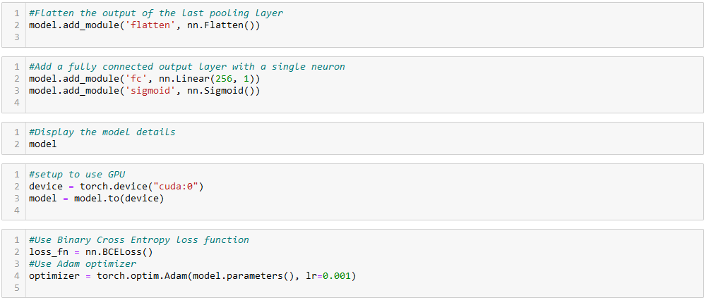
Code- Classifier_CatsDogs_Template.py

Slide 16
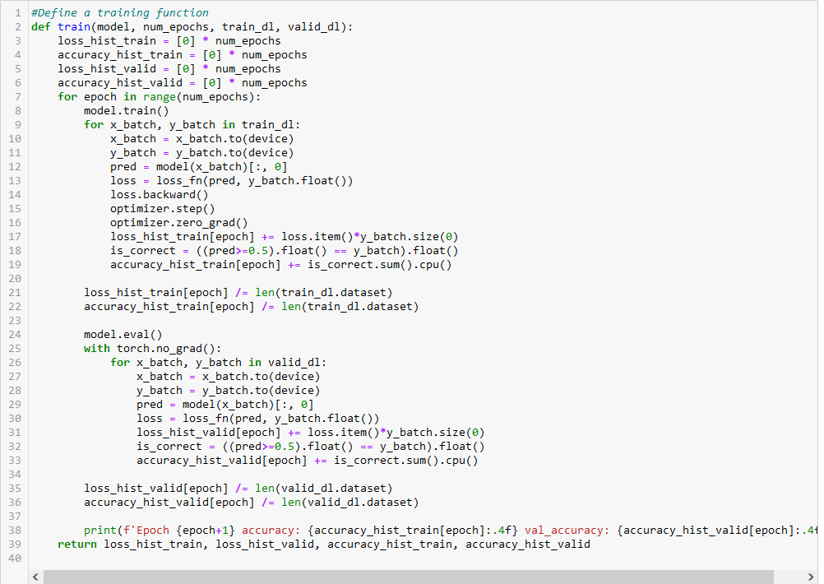
Code- Classifier_CatsDogs_Template.py

Slide 17
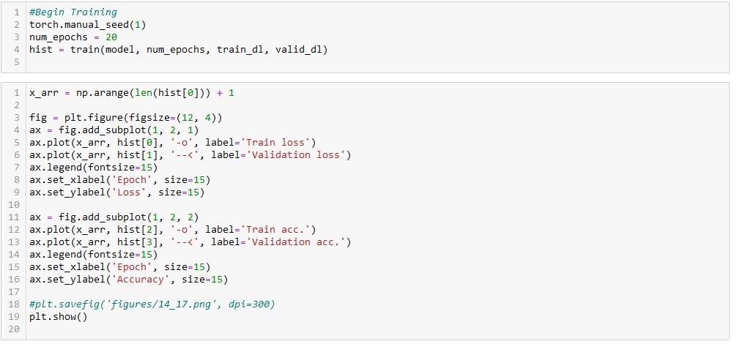
Code- Classifier_CatsDogs_Template.py

Slide 18
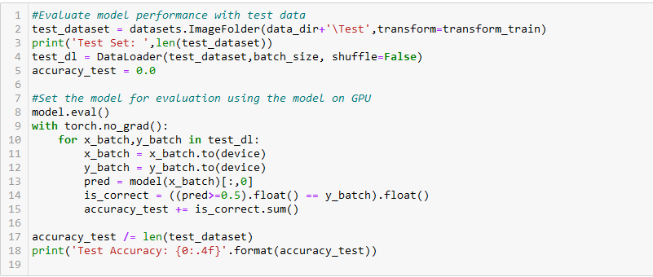
Code- Classifier_CatsDogs_Template.py

Slide 19
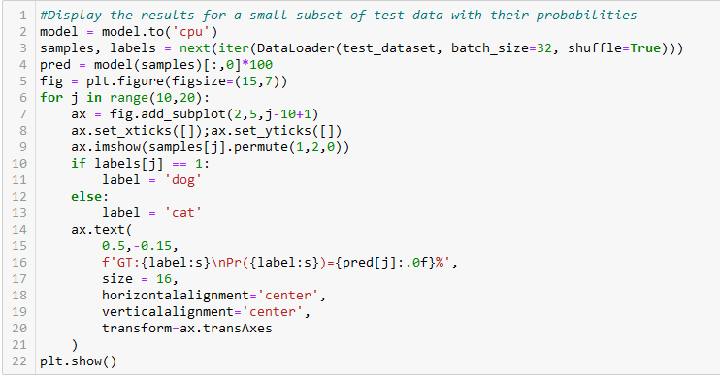
Code- Classifier_CatsDogs_Template.py

